Slide 1

New Forms of Data and the Analysis of Cities
Patrick Ballantyne, University of Liverpool
P.Ballantyne@liverpool.ac.uk

Slide 2

About Me
Postdoctoral Research Fellow:
Geographic Data Science Lab, University of Liverpool
Research Interests:
Retail, COVID-19, Geodemographics,
Consumer, Location and Mobility Data
New Forms of Data and the Analysis of Cities

Slide 3
Overview
New Forms of Data and the Analysis of Cities

Slide 4
Overview
Cities; form and function
New forms of data = insights
Retail centres; form and function
Reflections
New Forms of Data and the Analysis of Cities

Slide 5

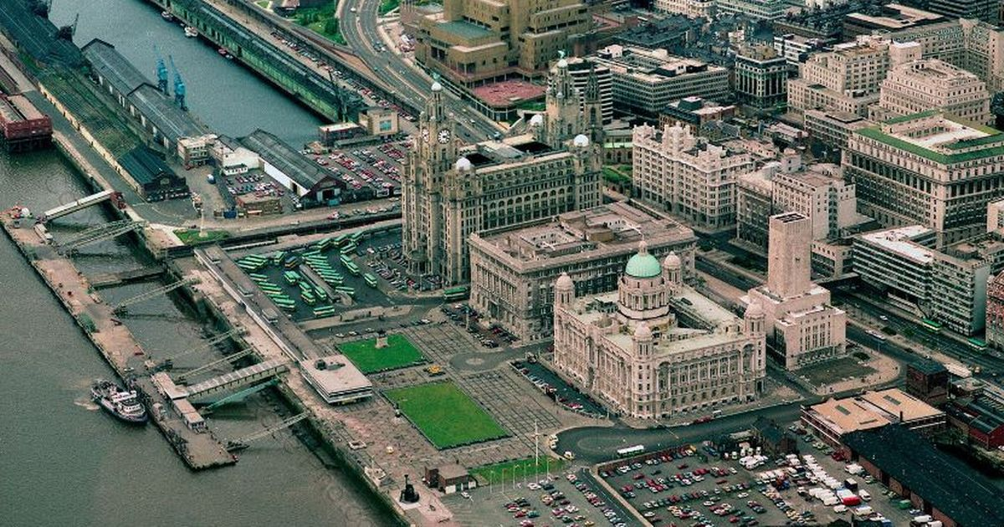
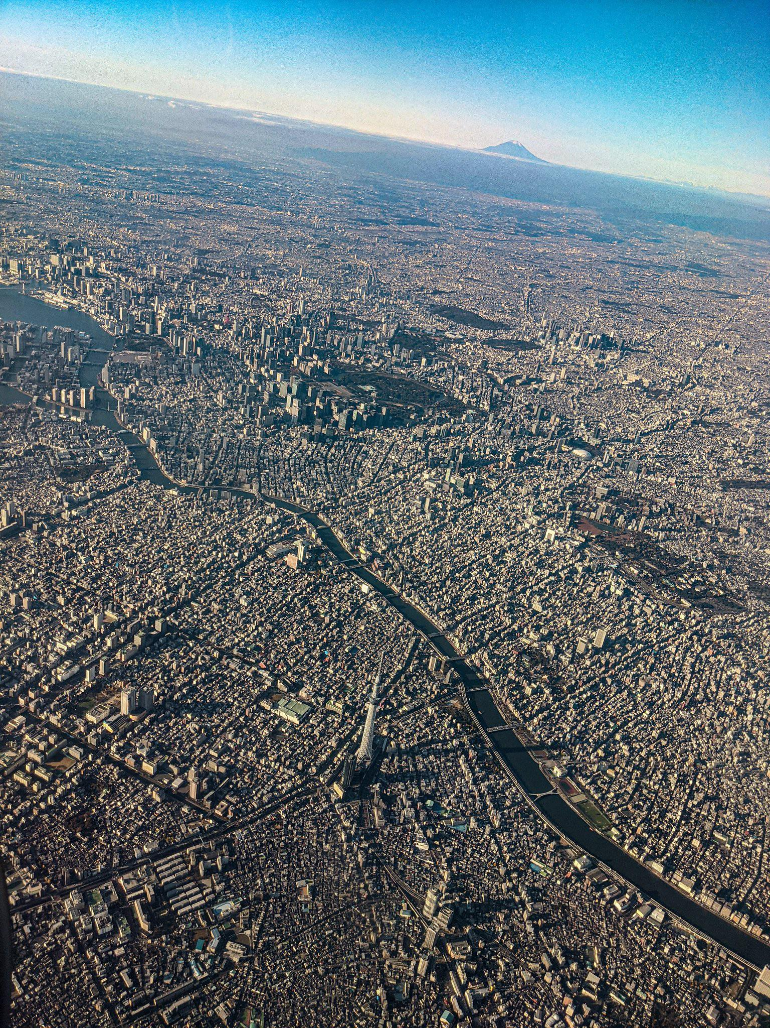
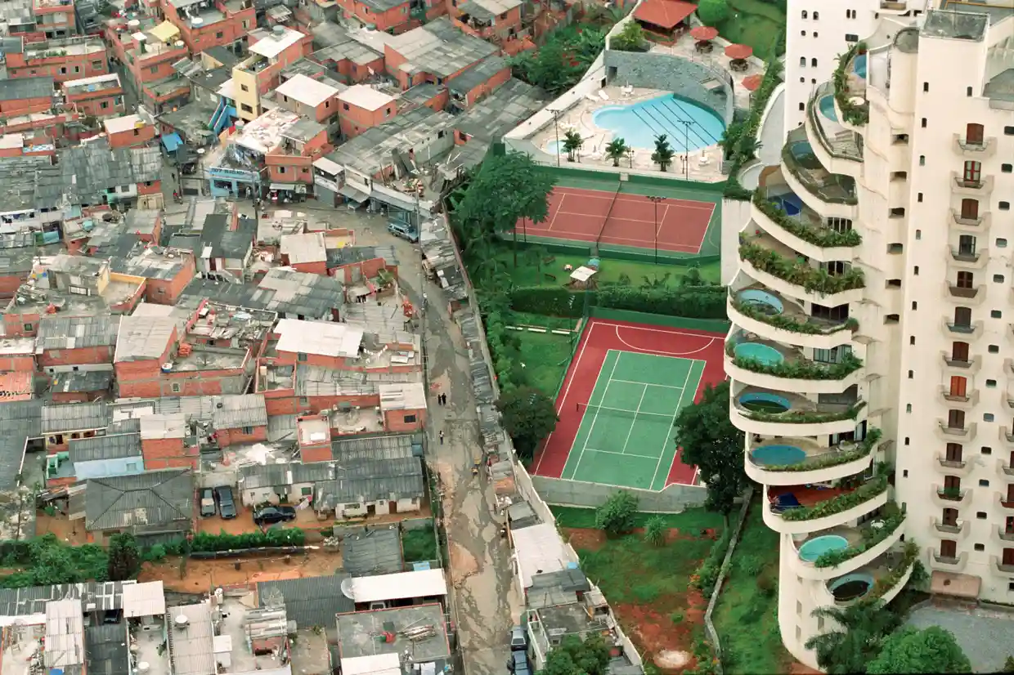
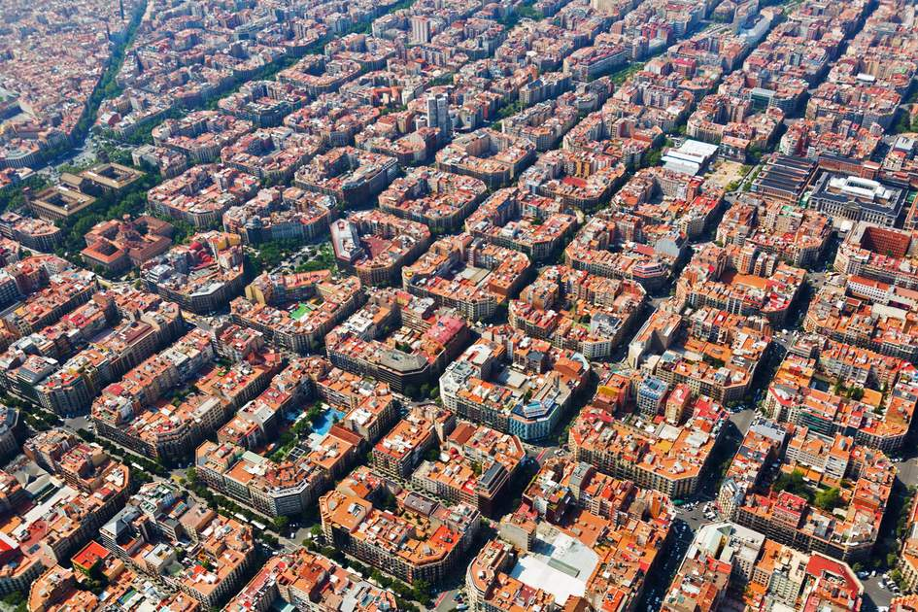
Cities
Tokyo, Japan
London, UK
Liverpool, UK
Sao Paulo, Brazil
New Forms of Data and the Analysis of Cities
Barcelona, Spain

Slide 6
Cities
Urban Form and Function
New Forms of Data and the Analysis of Cities
Notes:
This is my chosen way to talk to you about cities; based on my own interests…
But you can think of lots of different ways of viewing cities and data used to interact with them;
People who live there
Availability of green space/provision of mental health/wellbeing

Slide 7
Cities
Urban Form and Function
“The visible shape or configuration of something ...”
New Forms of Data and the Analysis of Cities

Slide 8
Cities
“The reason for which something exists...”
Urban Form and Function
“The visible shape or configuration of something ...”
New Forms of Data and the Analysis of Cities

Slide 9
Cities
Tokyo, Japan
London, UK
Liverpool, UK
Sao Paulo, Brazil
New Forms of Data and the Analysis of Cities
Barcelona, Spain
Notes:
Form:
TOKYO: Very densely packed, high-rise city
BARCELONA: Very distinctive morphology, grid system designed to unite poor and rich in the 1850s, gardens at the centre of each block.
SAO PAULO: Divisive urban morphology, urban favela against a luxury hotel
Function:
LONDON: Financial capital of UK
LIVERPOOL: Cultural city (stags, hen dos), port city
BARCELONA: One of the only beach cities of the world, cultural, food.

Slide 10

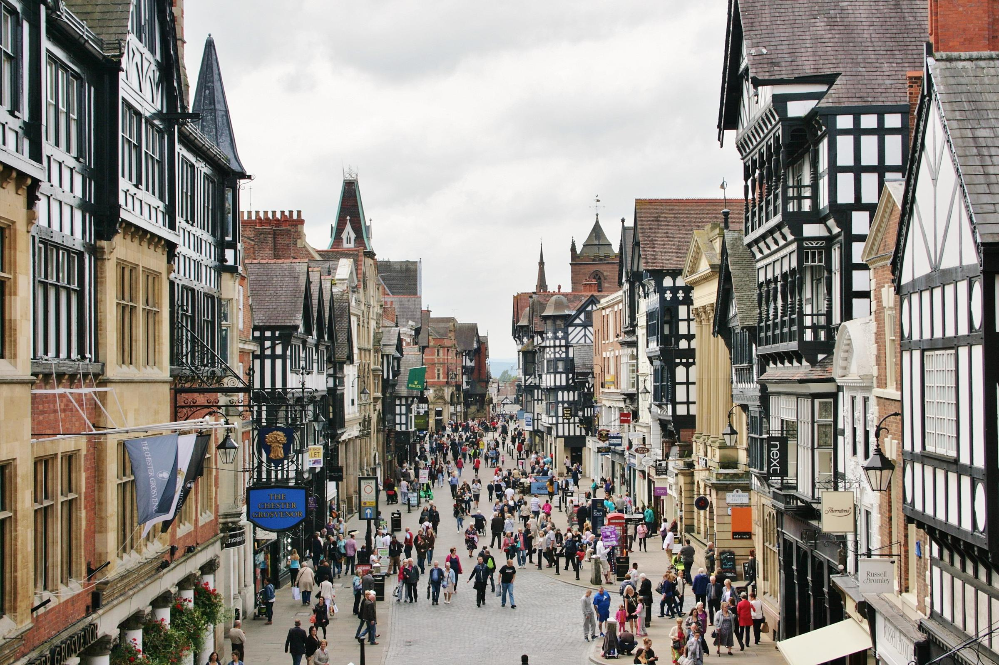
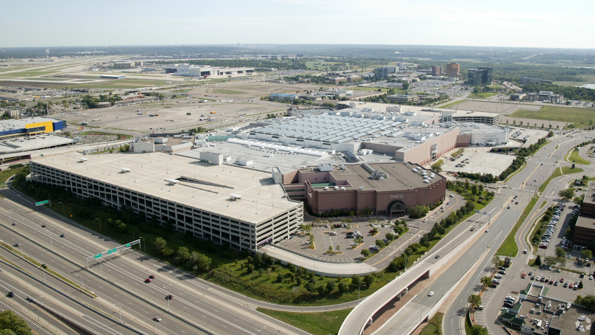

Retail
Chester, UK
Marrakesh, Morocco
Bloomington, U.S.
New Forms of Data and the Analysis of Cities
Shinjuku, Japan
Notes:
Very different forms present in retail too!
Talk about forms, how they differ (mall vs souk vs high street vs Kabukicho)
Stress functions; malls in the US typically providing a very different offering to say the Souk's in Marrakesh

Slide 11
Cities Matter!
New Forms of Data and the Analysis of Cities
Notes:
Other concepts;
They only cover about 1% of the earth’s surface; thus, they do not take up as much space as you would think.
They are responsible for 70% of global CO2 emission; climate change agenda.
Geographical phenomena, linked with all sorts of socio-economic, geo-political and environmental issues.

Slide 12
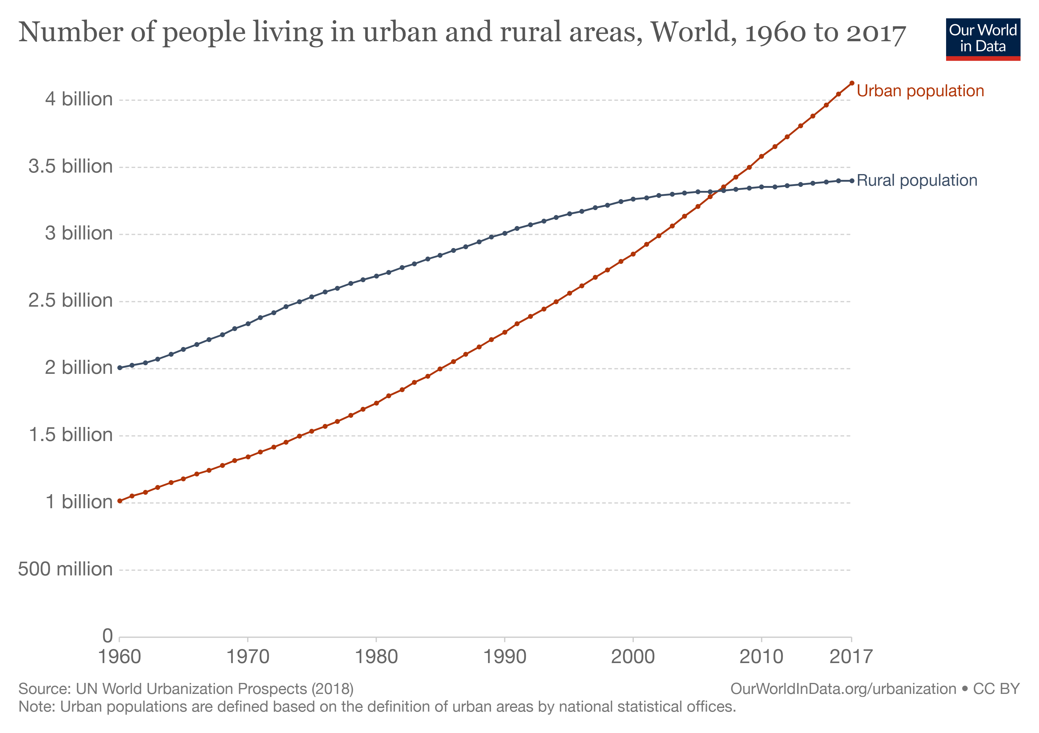
Cities Matter!
Over 50% of the world’s population live in cities...
New Forms of Data and the Analysis of Cities
Notes:
Other concepts;
They only cover about 1% of the earth’s surface; thus, they do not take up as much space as you would think.
They are responsible for 70% of global CO2 emission; climate change agenda.
Geographical phenomena, linked with all sorts of socio-economic, geo-political and environmental issues.

Slide 13

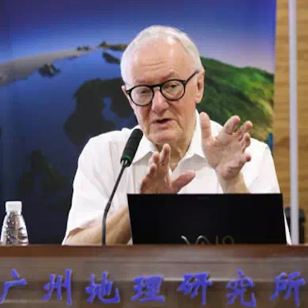
Cities Are Complex!
“Cities are largely unpredictable because they are complex systems that are more like organisms than machines. Neither the laws of economics nor the laws of mechanics apply; cities are the product of countless individual and collective decisions that do not conform to any grand plan. They are the product of our inventions; they evolve”.
New Forms of Data and the Analysis of Cities

Slide 14
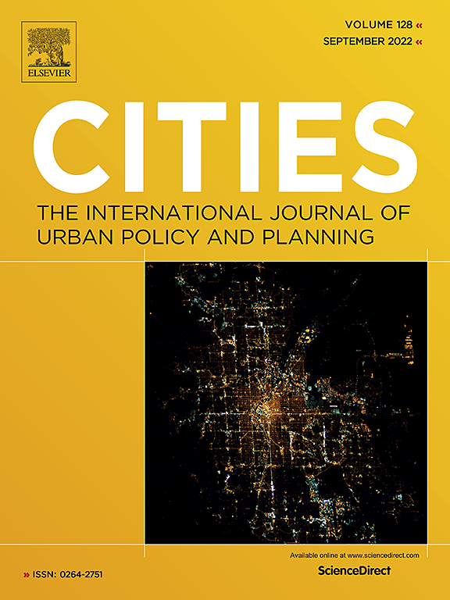
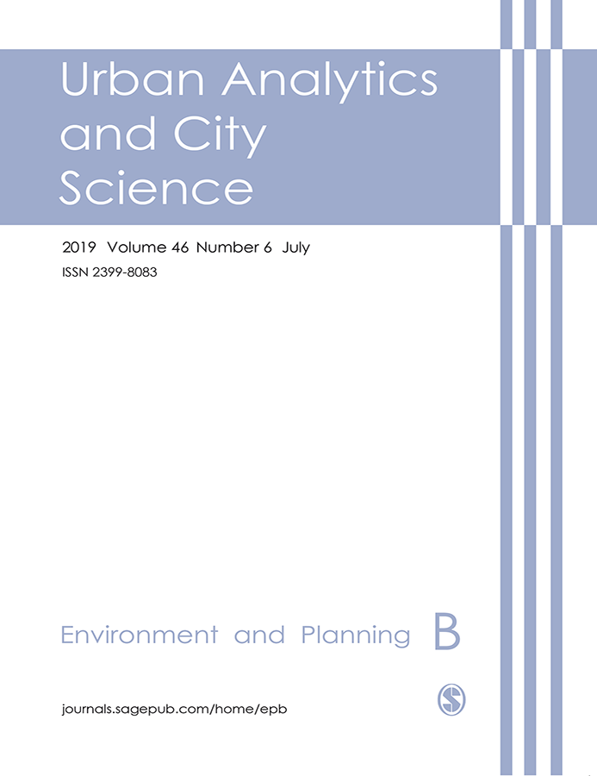
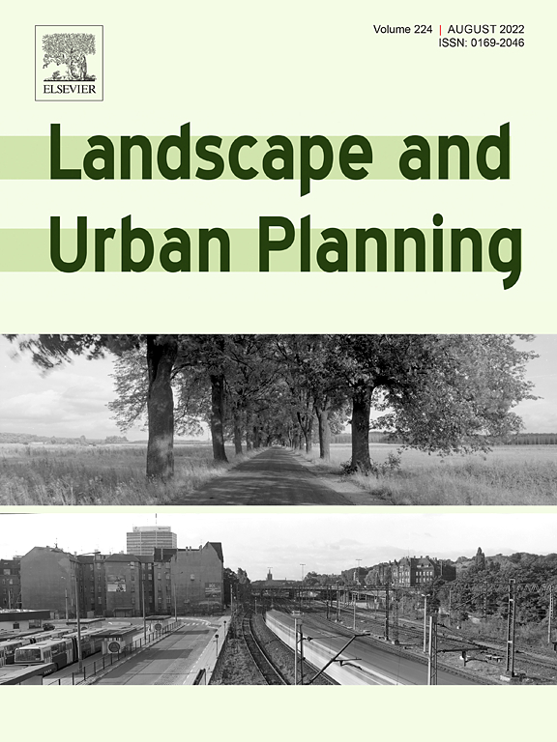

Cities Are Complex!
And many more...
New Forms of Data and the Analysis of Cities

Slide 15
Overview
Cities; form and function
New forms of data = insights
Retail centres; form and function
Reflections
New Forms of Data and the Analysis of Cities
Notes:
In this next section I’m going to walk you through some of (in my opinion) the most exciting developments in data

Slide 16

Data, Data, Data!
There has never been a time in history with more abundant geographic data, offering great potential for the spatially enabled social sciences to advance understanding of a plethora of human and environmental problems (Elwood, Goodchild, and Sui 2012)
New Forms of Data and the Analysis of Cities
Notes:
This is from an excellent paper on the future of Geographic Data Science; Singleton and Arribas-Bel
Much more data, much more geographic data, means we live at an exciting time where we can use this abundance of geographic data to generate NEW insights!

Slide 17
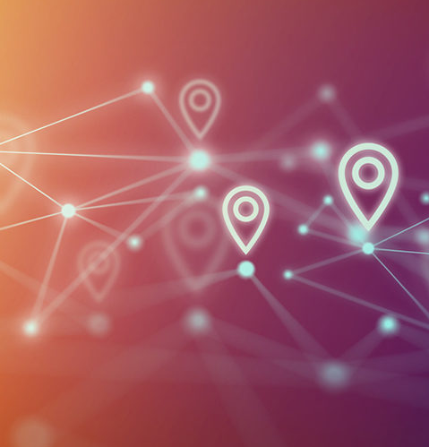

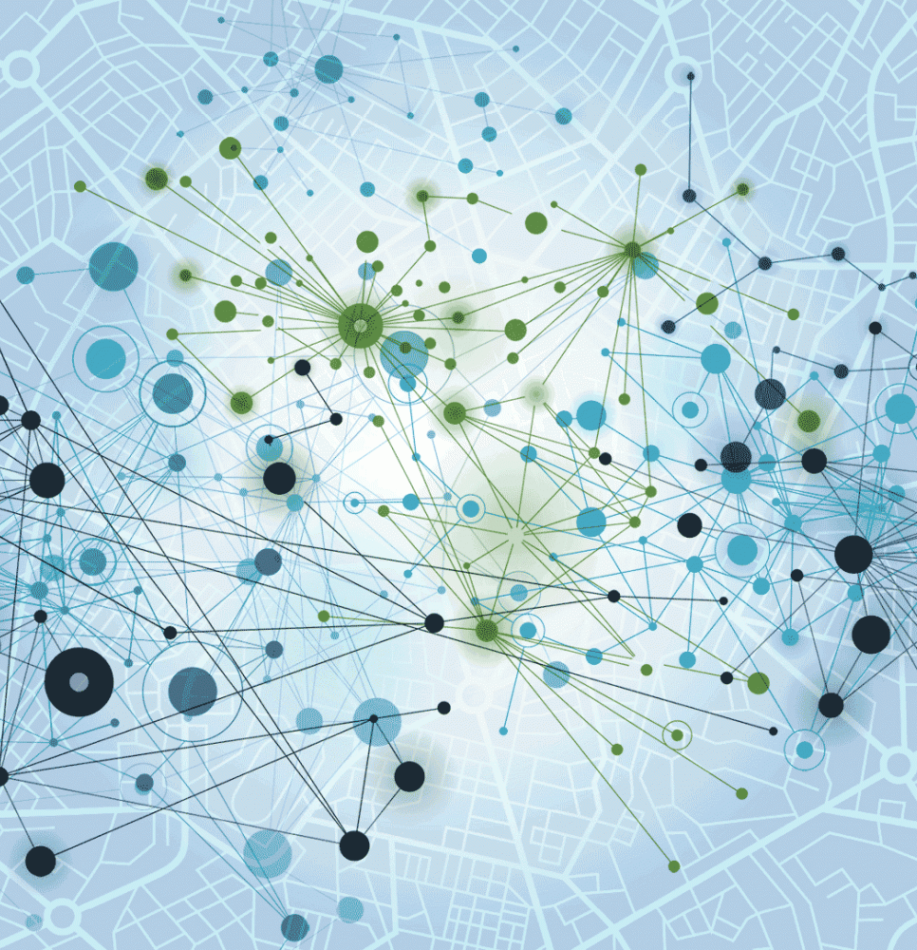
Data, Data, Data!
Location
Consumer
Mobility
New Forms of Data and the Analysis of Cities
Notes:
I’m going to talk to you about developments in three types of data that I have a lot of experience working with:
Location data
Consumer data
Mobility data

Slide 18
Data, Data, Data!
Location
New Forms of Data and the Analysis of Cities

Slide 19
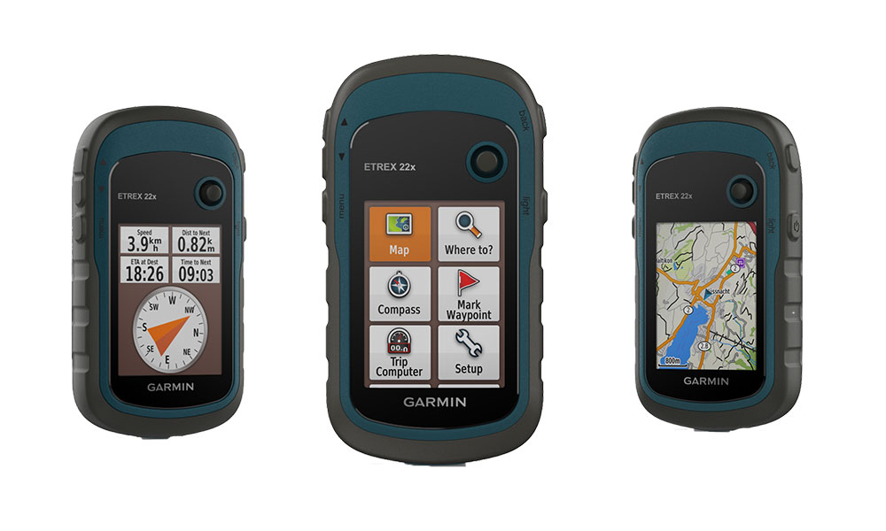
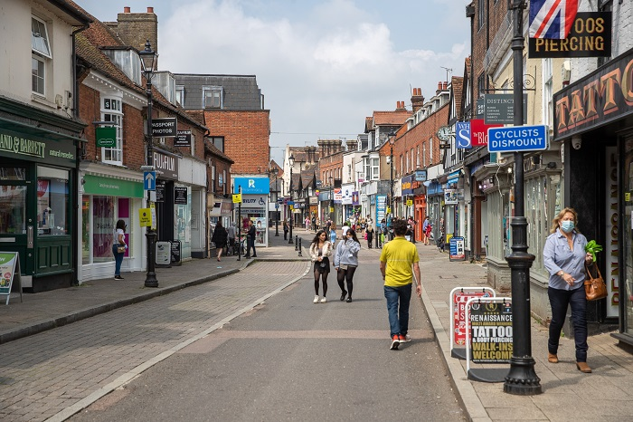
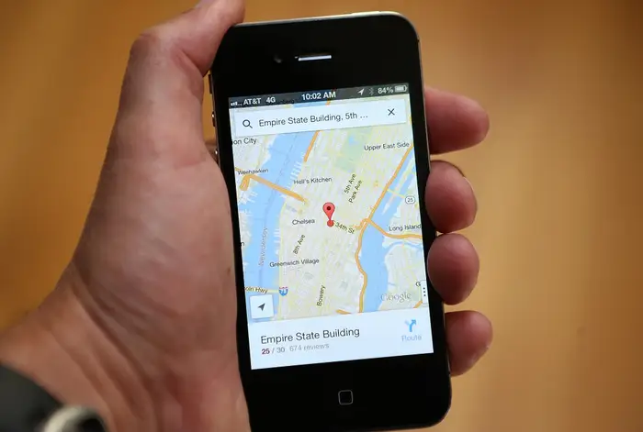
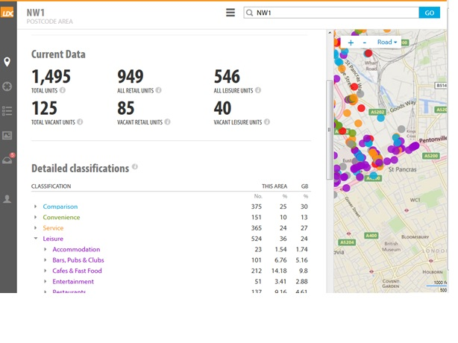

Location Data
New Forms of Data and the Analysis of Cities
Notes:
Lots of ways we can collect location data manually.
GPS recorder; records your position, coordinates, use it to find your way
Phones have now become daily GPS; google maps…
Surveys by Local Data Company to verify location of retailers; challenging at UK scale, not updated regularly enough, privileges certain locations based on sampling

Slide 20
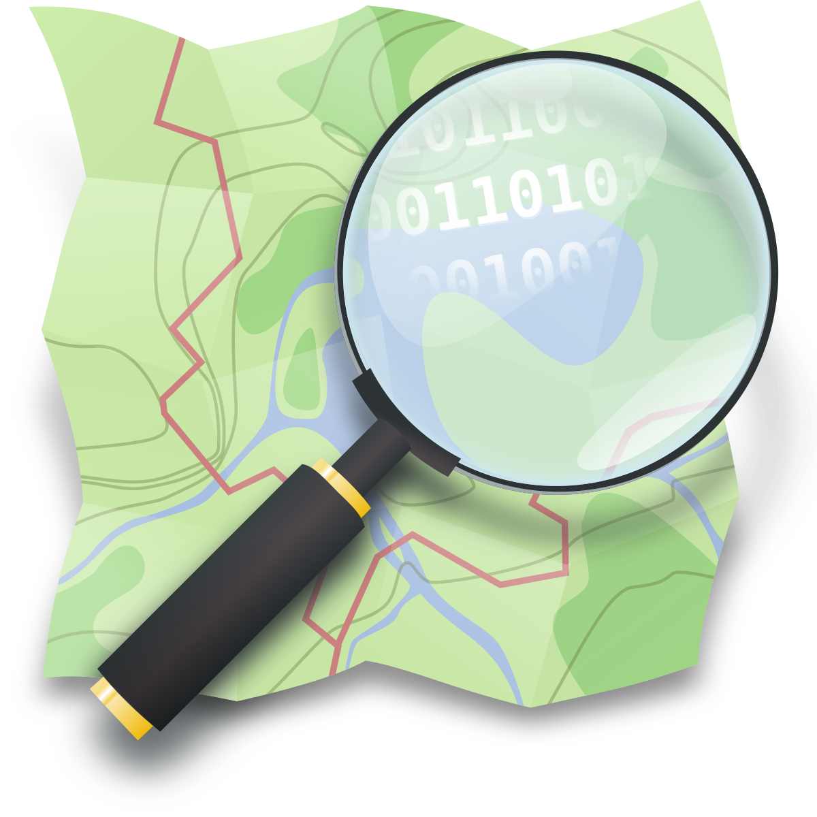
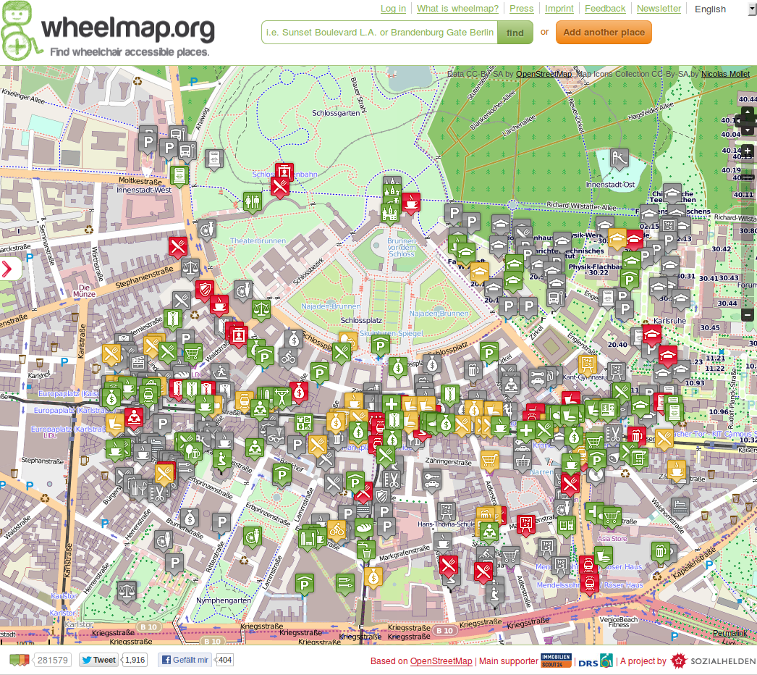
Location Data - OpenStreetMap
New Forms of Data and the Analysis of Cities
Notes:
OpenStreetMap; crowdsourcing data, open source
Enabled lots of research
Has lots of problems relating to who uploads data, what is the accuracy of the data and actual coverage of OSM

Slide 21
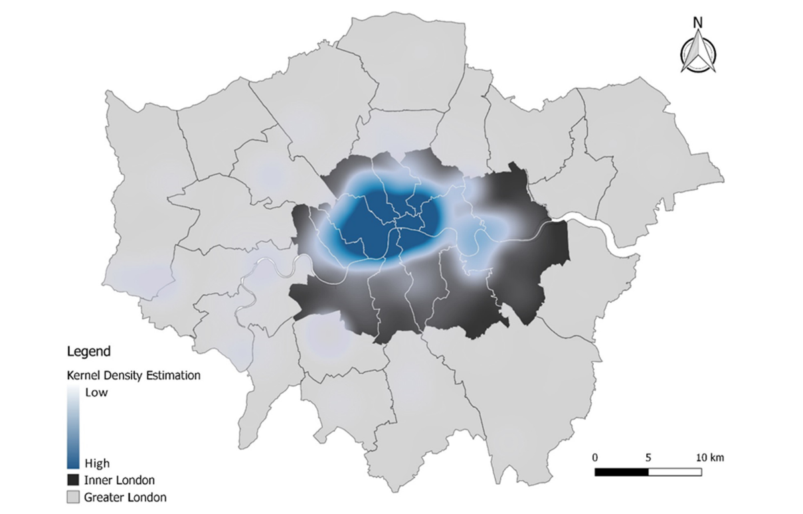
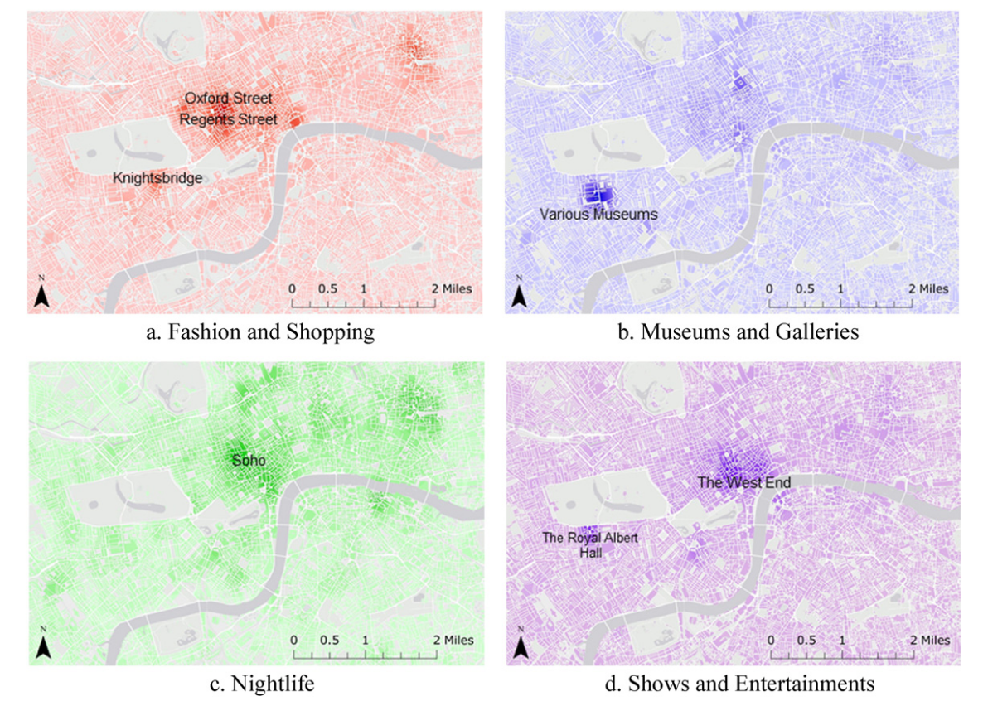


Location Data – VGI
Chen, M., Arribas-Bel, D. and Singleton, A. 2019. Understanding the dynamics of urban areas of interest through volunteered geographic information. Journal of Geographical Systems.
Lansley, G. and Longley, P.A. 2016. The geography of Twitter topics in London. Computers, Environment and Urban Systems.
New Forms of Data and the Analysis of Cities
Notes:
Location data that we might not think are being generated by our daily activities; Volunteered Geographic Information (VGI)
Social media platforms like Flickr and Twitter generate geo-tagged information
Used in research too as often openly accessible through APIs, like the API for Twitter and Flickr
Two examples here…

Slide 22
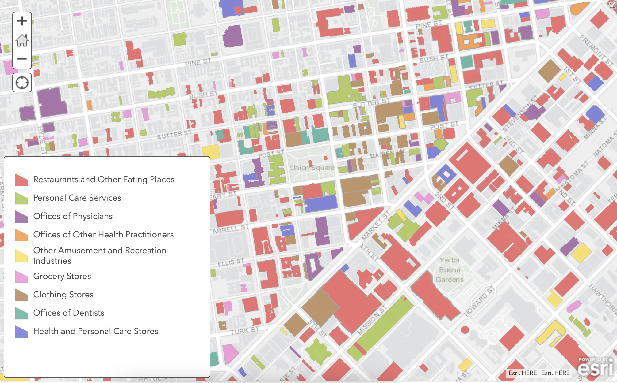

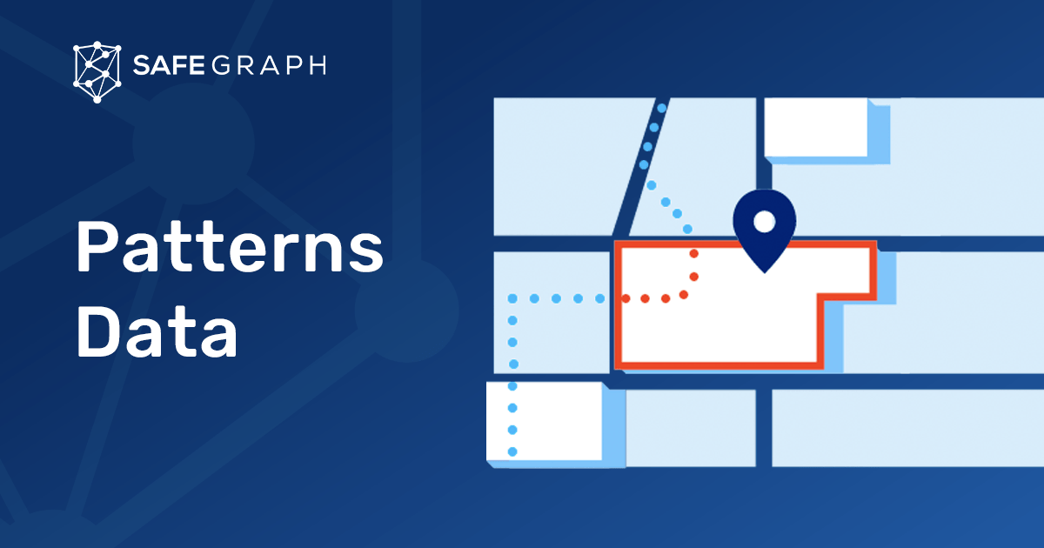
Location Data – SafeGraph
New Forms of Data and the Analysis of Cities
Notes:
Big companies like SafeGraph use more sophisticated methods;
Crawling websites of retailers, major brands
Using Open APIs to access locations of places, POIs
Machine learning to infer characteristics of places
Means they are able to generate much more robust POI datasets, that can be updated much more regularly…
However, often an issue with data like these is they are expensive, and rarely open source…

Slide 23


Location Data – SafeGraph (2)
New Forms of Data and the Analysis of Cities
Notes:
HOWEVER!
There is some good news; SafeGraph make their data open source for academics, doing research for public good…
As a result they have lots of articles published using their data!

Slide 24
Data, Data, Data!
Consumer
New Forms of Data and the Analysis of Cities
Notes:
What is consumer data?

Slide 25
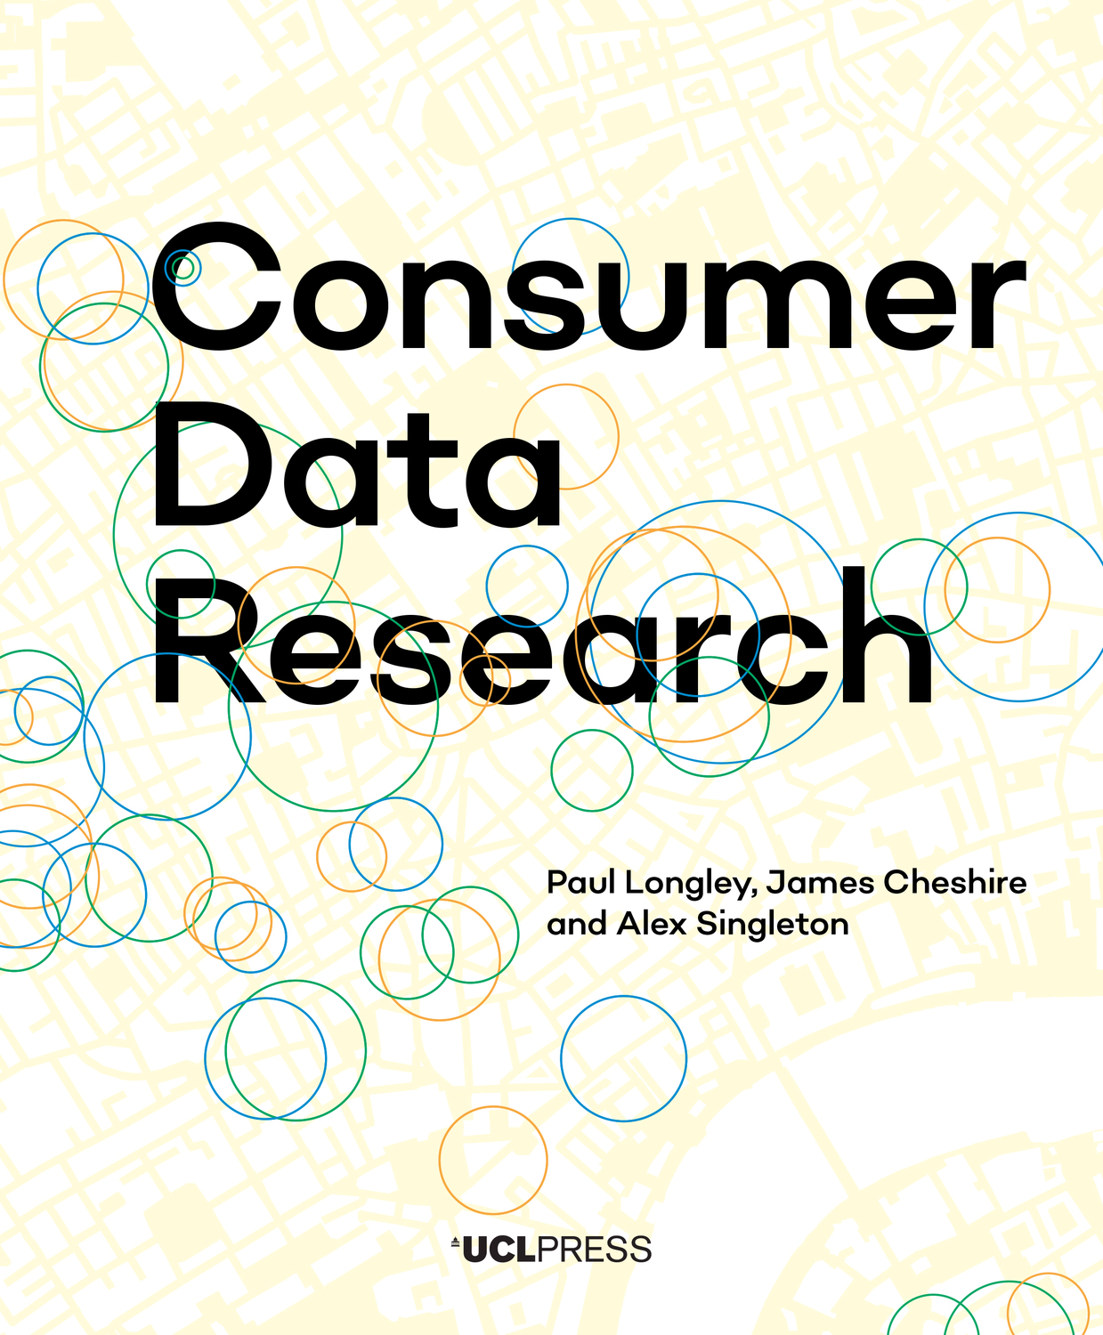
Consumer Data
“...data that arises out of everyday transactions for goods and services, carried out between individuals and organisations...
“...created as a by-product of the consumer transactions that created them”
Read Free: https://www.uclpress.co.uk/products/114094
New Forms of Data and the Analysis of Cities

Slide 26

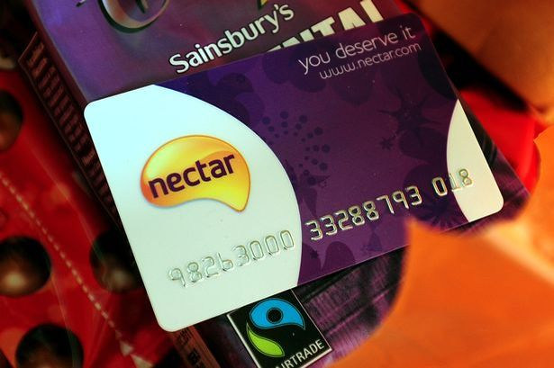
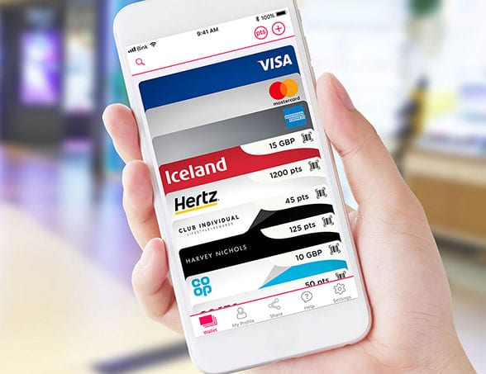

Consumer Data
New Forms of Data and the Analysis of Cities
Notes:
Purpose: to encourage customers to stay loyal to them, through provision of rewards… But also provides a direct way for retailers to better understand their customers, through collection of information about them and their purchasing behaviours.
Information about:
The customer; their characteristics, their living arrangements, family etc.
The products; who is buying which products, and to what level of demand
The geography; where are people coming from to shop in their stores.
Some examples here; major retailers of the UK
Really cool development is having them on your phone; for someone like me I don’t want to carry lots of them around with me everywhere…

Slide 27
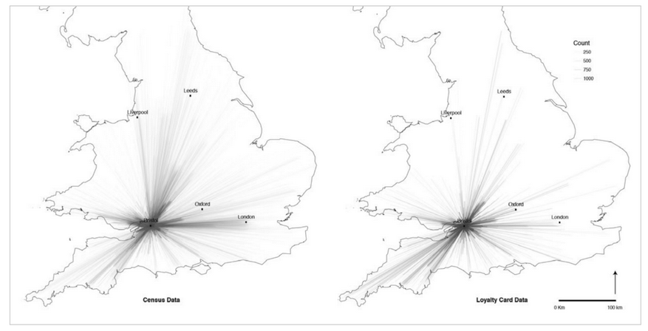
Consumer Data
Lloyd, A., Cheshire, J., Squires, M. 2018. The provenance of customer loyalty card data. Consumer Data Research.
New Forms of Data and the Analysis of Cities
Notes:
First thing we can is infer geography; this from a paper by researchers at UCL
It shows how we can use loyalty card data as a direct comparison for census estimates; in this case estimating movement of people within the UK…
Loyalty cards help us better understand social processes, and are more effective because data has much better temporal resolution than census.

Slide 28
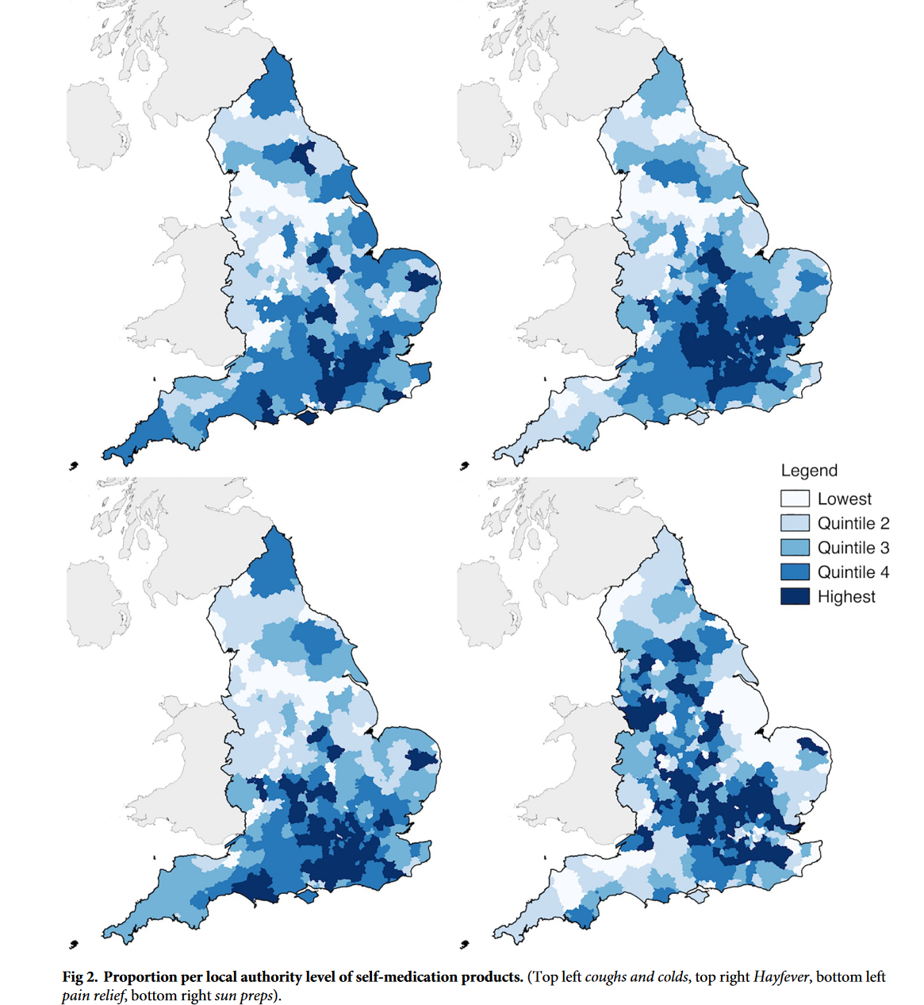
Consumer Data
Davies, A., Green, M., Singleton, A. Using machine learning to investigate self-medication purchasing behaviours via high street retailer loyalty card data. PloS one.
New Forms of Data and the Analysis of Cities
Notes:
Loyalty cards have also been used in other fields too; this one from medical geography

Slide 29
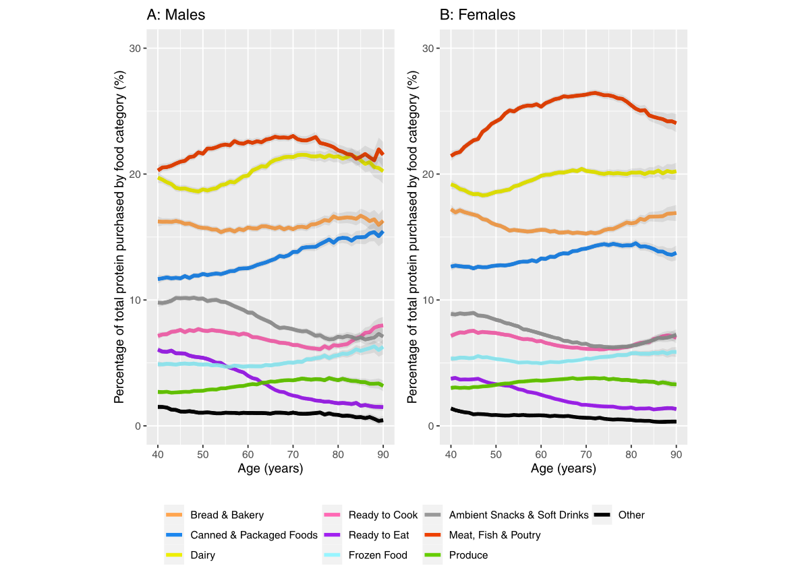
Consumer Data
Green, M.A., Watson, A.W., Brunstrom, J.M., Corfe, B.M., Johnstone, A.M., Williams, E.A. and Stevenson, E. 2020. Comparing supermarket loyalty card data with traditional diet survey data for understanding how protein is purchased and consumed in older adults for the UK, 2014–16. Nutrition journal.
New Forms of Data and the Analysis of Cities
Notes:
And another

Slide 30
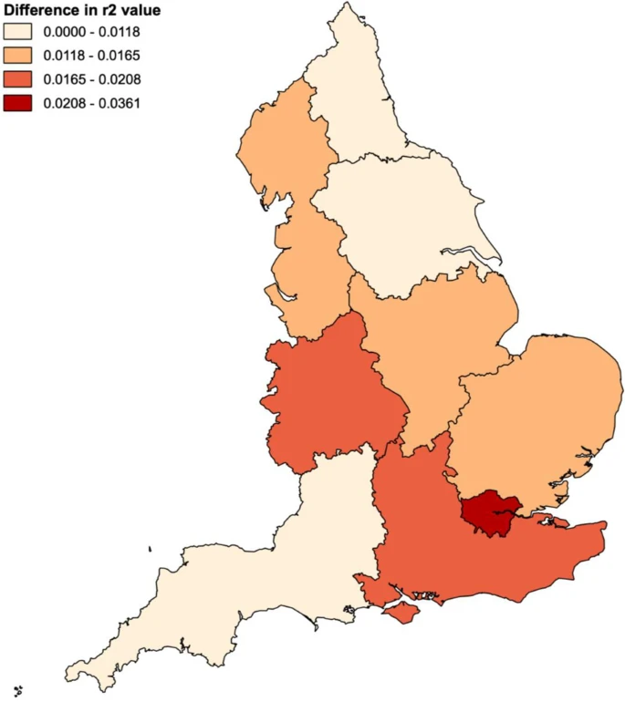
Consumer Data
Rose, N., Dolega, L, 2021. It’s the weather: quantifying the impact of weather on retail sales Applied Spatial Analysis and Policy .
New Forms of Data and the Analysis of Cities
Notes:
And another using loyalty cards with weather data to look at interactions between store sales and the weather

Slide 31
Mobility Data
Mobility
New Forms of Data and the Analysis of Cities
Notes:
Can think of it as data describing peoples movement’s through space during normal activities, collected by smartphones…

Slide 32
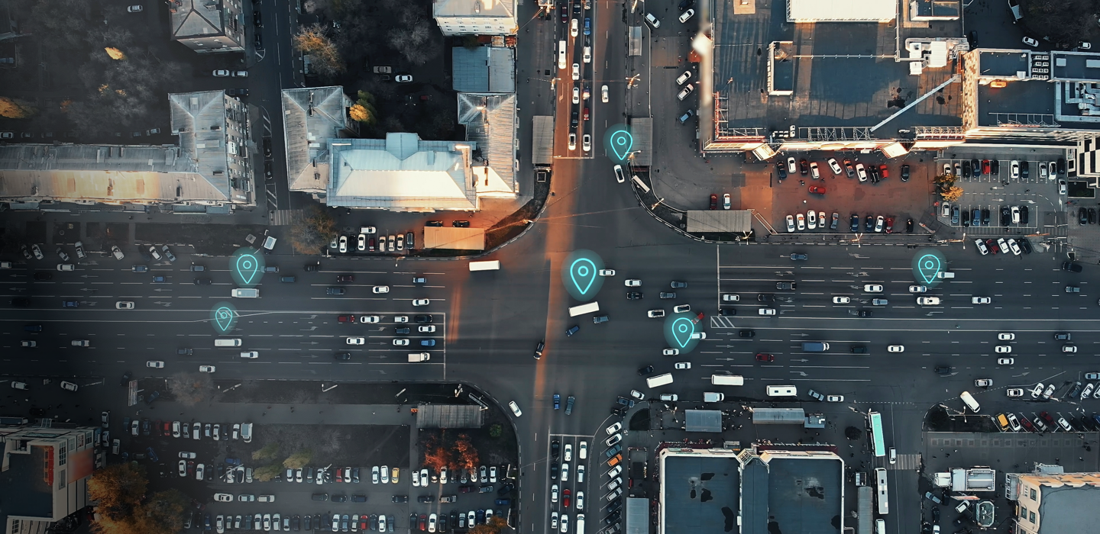
Mobility Data
New Forms of Data and the Analysis of Cities
Notes:
Can think of it as data describing peoples movement’s through space during normal activities, collected by smartphones…

Slide 33
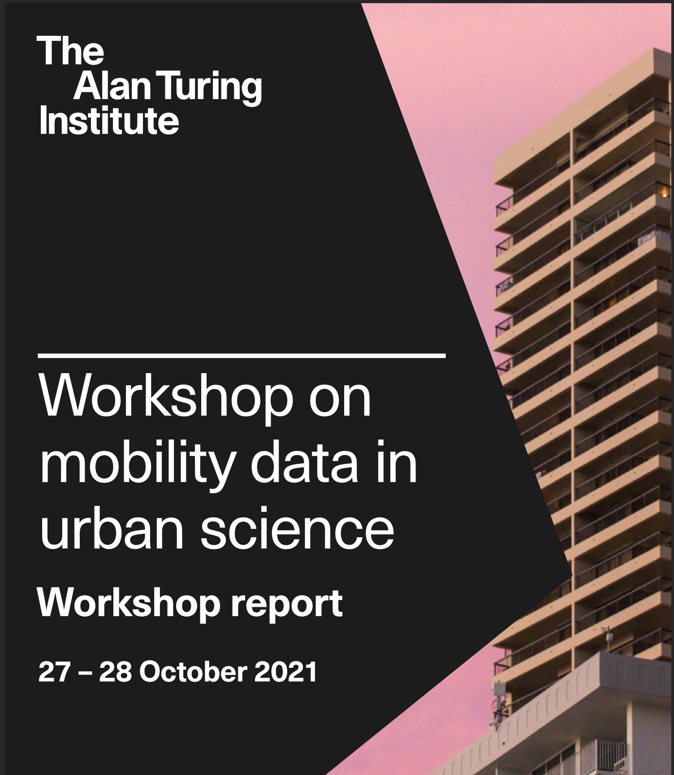
Mobility Data
Data have become a central pillar of society. Technological advances in computational power, storage and network platforms have enabled the production, processing, analysis and storage of large volumes of digital data. Information that previously could not be stored, or captured can now be digitally recorded.
A key data stream has been location data from mobile phones. More generally, mobile phone data are a rich source of information offering a unique opportunity to capture human behaviour at an unprecedented geographic and temporal resolution. Yet, key challenges remain, such as issues about privacy, representativeness, biases and the use of large, noisy and complex data sets
New Forms of Data and the Analysis of Cities
Notes:
The potential of mobility is huge!
Going to walk you through some examples of mobility data and how they are used

Slide 34
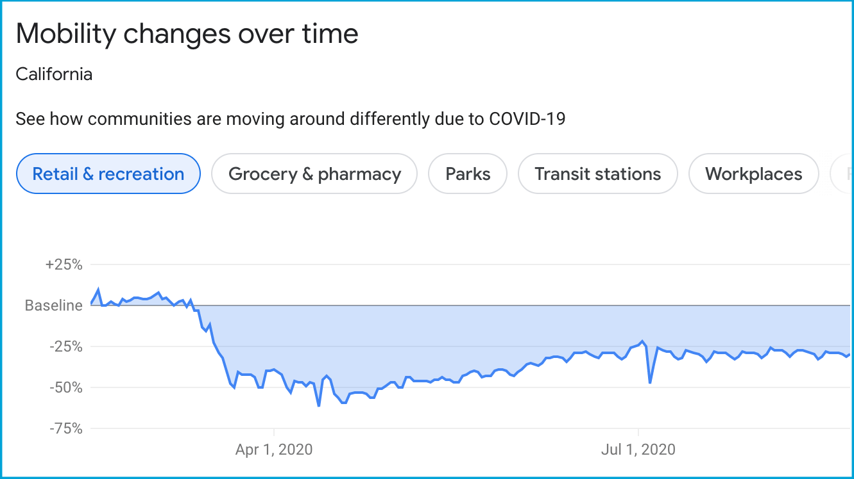

Mobility Data
New Forms of Data and the Analysis of Cities
Notes:
Google mobility reports; available by different activities

Slide 35
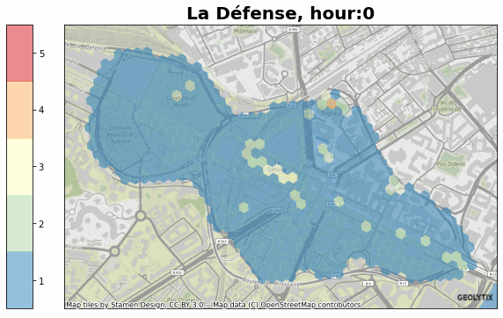
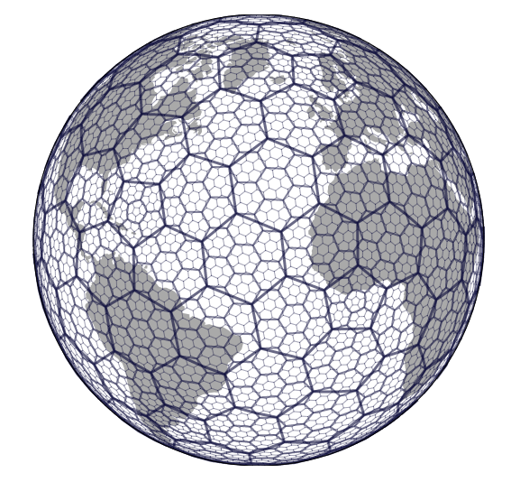

Mobility Data
New Forms of Data and the Analysis of Cities
Notes:
Geolytix data; appended to H3 cells.
By dividing the world into hexagons, we can apportion other datasets to them…
Geolytix data provides a measure of hourly mobility for the UK

Slide 36
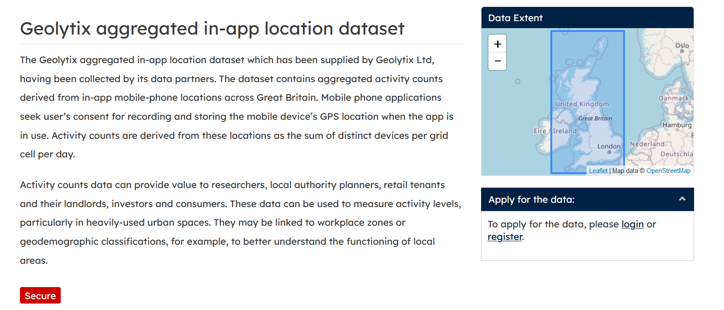
Mobility Data
data.cdrc.ac.uk/Geolytix-aggregated-app-location-dataset
New Forms of Data and the Analysis of Cities
Notes:
Available to work with within the CDRC
DSH, Trusted Research Environments

Slide 37
Mobility Data
data.cdrc.ac.uk/Geolytix-aggregated-app-location-dataset
Ballantyne, P., Singleton, A., Dolega, L. forthcoming. Retail centres and COVID-19: functional, structural and spatial responses to Omicron.
New Forms of Data and the Analysis of Cities
Notes:
I’ve used the Geolytix data in my most recent paper.
Because retail centres are available at H3, and so is the data, we can fuse the two together and generate new insights
In this case, we are unpacking how retail centres have responded to the COVID-19 pandemic.

Slide 38
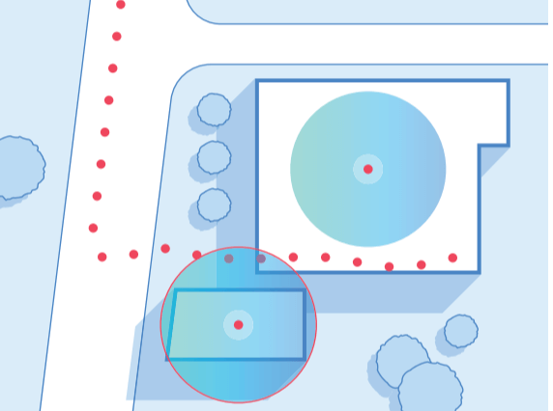
Mobility Data
New Forms of Data and the Analysis of Cities
Notes:
SafeGraph have developed a new form of mobility data by appending mobility data to their POIs
By using a sophisticated methodology, they are able to accurately predict the number of visitors, visits and area travelled to of their consumers
Some really useful insights

Slide 39
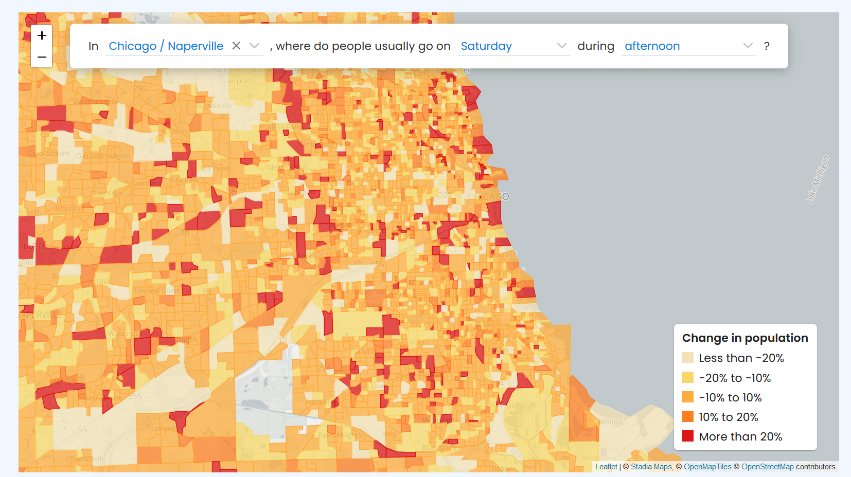
Mobility Data
New Forms of Data and the Analysis of Cities
Notes:
Looking at movement of people in Chicago at specific times of the day/week

Slide 40
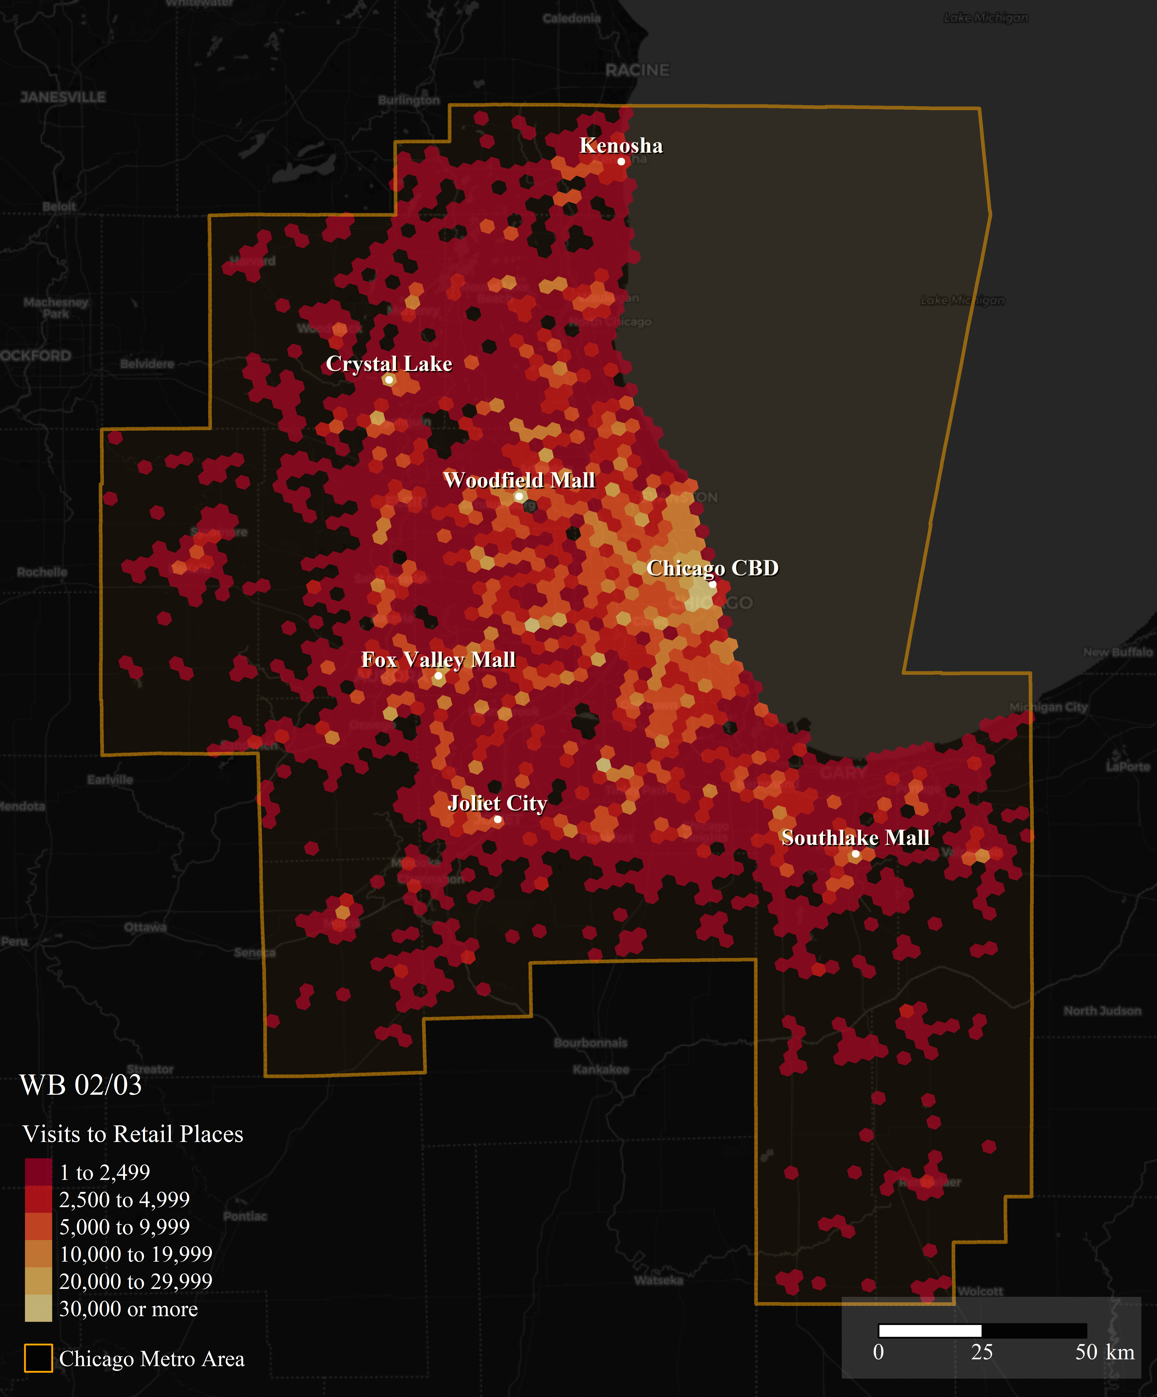
Mobility Data
Ballantyne, P., Singleton, A., Dolega, L. 2021. A regional exploration of retail visits during the COVID-19 pandemic. Regional Studies, Regional Science.
New Forms of Data and the Analysis of Cities
Notes:
Changing popularity of stores during early weeks of the pandemic.

Slide 41
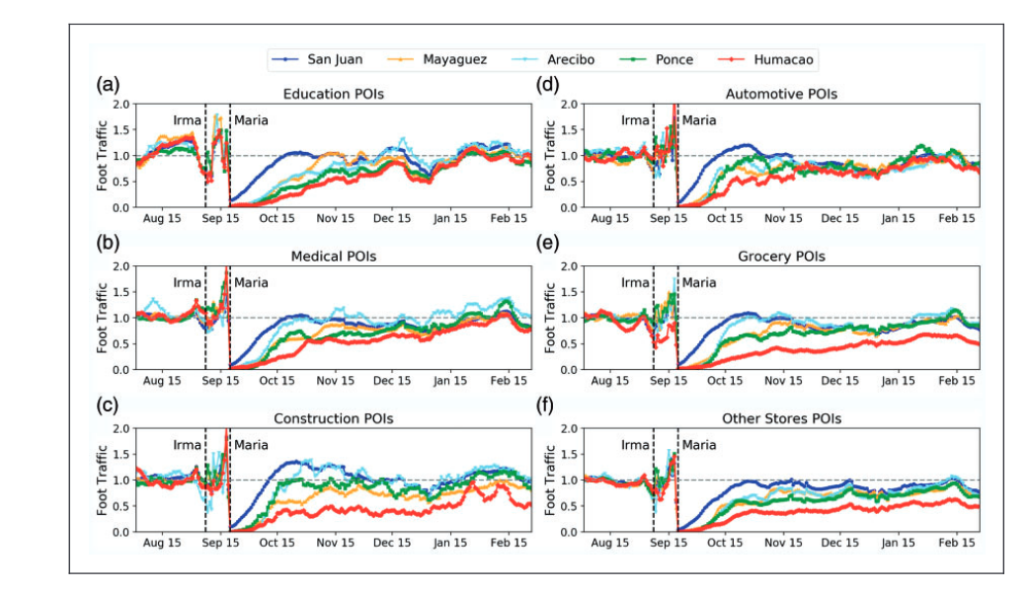
Mobility Data
Yabe, Y., Suresh, P., Rao, C., Ukkusuri, S. 2020. Regional differences in the resilience of social and physical systems: Case Study of Puerto Rico after Hurricane Maria. Environment and Planning B: Urban Analytics and City Science.
New Forms of Data and the Analysis of Cities
Notes:
Or even more left field…
How different types of POIs/services responded to a Hurricane in Puerto Rico

Slide 42
Data, Data, Data!
Location
Consumer
Mobility
New Forms of Data and the Analysis of Cities

Slide 43
Overview
Cities; form and function
New forms of data = insights
Retail centres; form and location
Reflections
New Forms of Data and the Analysis of Cities

Slide 44
Retail
Chester, UK
Marrakesh, Morocco
Bloomington, U.S.
New Forms of Data and the Analysis of Cities
Shinjuku, Japan
Notes:
Back to my previous examples of different forms and functions of retailing
I’m going to be talking about some of the work I have been doing to distinguish different forms and functions of retail centres in the US.

Slide 45
Retail centres; form and location
Urban Form and Function
“The visible shape or configuration of something ...”
New Forms of Data and the Analysis of Cities

Slide 46
Retail centres; form and location
Where are these located?
Urban Form and Location
“The visible shape or configuration of something ...”
New Forms of Data and the Analysis of Cities
Notes:
Whilst the form of the spaces is an important question, part of this relates to a question of where too; where in geographical space do these retail centres exist
And how can we quantify this?

Slide 47
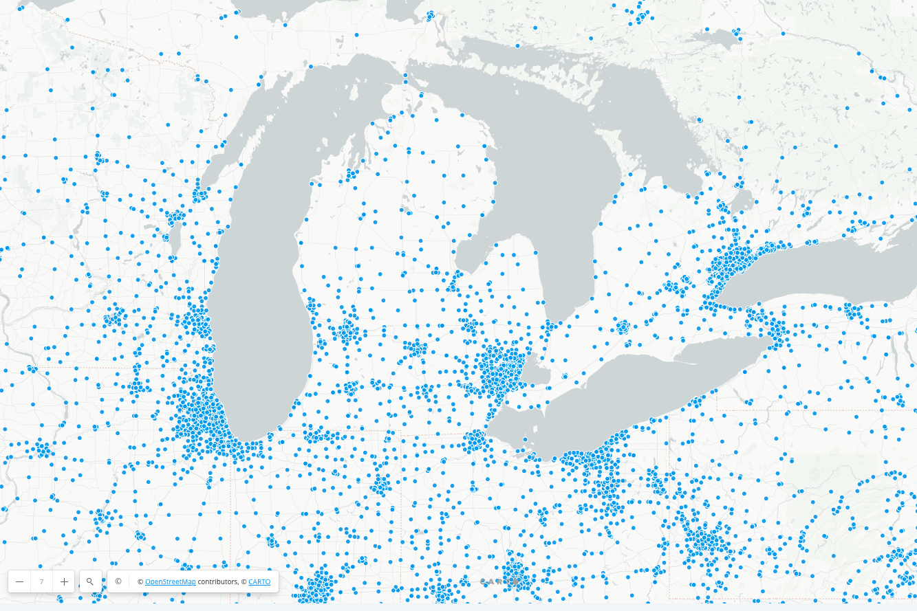
Retail centres; form and location
New Forms of Data and the Analysis of Cities
Notes:
Our key dataset of use is the SafeGraph places database; looks this for the US
How do we turn this raw distribution of POIs into something that summarises the form and location of retail centres?

Slide 48
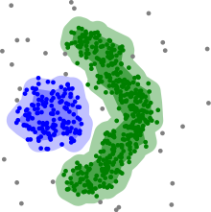
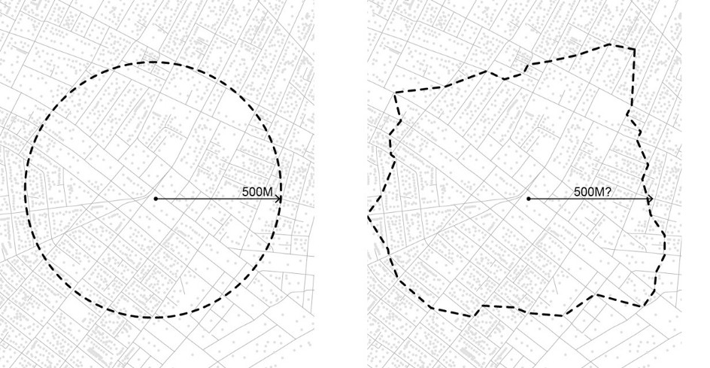
Retail centres; form and location
DBSCAN:
Density-based spatial clustering of applications with noise
Network Routing
New Forms of Data and the Analysis of Cities
Notes:
Integrated DBSCAN and Networking Routing…

Slide 49
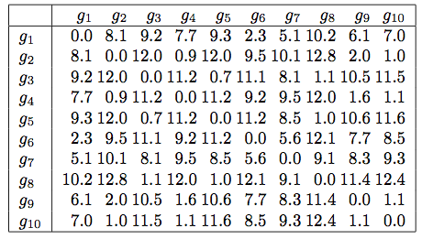
Retail centres; form and location
DBSCAN:
Density-based spatial clustering of applications with noise
Network Routing
New Forms of Data and the Analysis of Cities
Notes:
This is what a distance matrix looks like; distance (by road) between each individual point in space, used as input to algorithm.

Slide 50
Retail centres; form and location
Ballantyne, P., Dolega, L., Singleton, A., Credit, K. A framework for delineating the scale, extent and characteristics of American retail centre agglomerations. Environment and Planning B: Urban Analytics and City Science.
New Forms of Data and the Analysis of Cities
Notes:
We delineated retail centres for Chicago; form and location

Slide 51
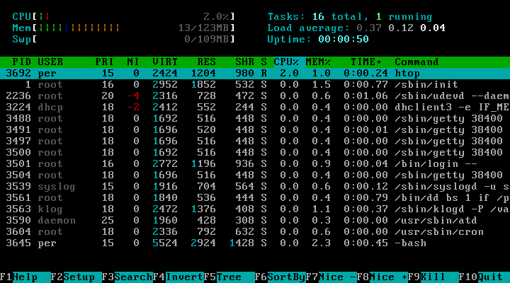

Retail centres; form and location
New Forms of Data and the Analysis of Cities
Notes:
However, this research came at a significant computational cost; parallelisation and memory maximisation struggled.
We need something that can upscale to the rest of the U.S.?

Slide 52
Retail centres; form and location
Computationally Effective!
Interpretable!
New Forms of Data and the Analysis of Cities
Notes:
H3; interoperable and computationally effective.
Based on Javascript libraries, so can do spatial operations within H3 very fast and low cost…
Interpretable; easy to explain how these operations work, basic GIS operations rather than sophisticated spatial clustering etc.

Slide 53
Retail centres; form and location
New Forms of Data and the Analysis of Cities
Notes:
Method walkthrough
Using SafeGraph data; places (points and building footprints), OpenStreetMap landuse polygons
Much better capture of forms… Let me show you!

Slide 54
Retail centres; form and function
New Forms of Data and the Analysis of Cities

Slide 55
Overview
Cities; form and function
New forms of data = insights
Retail centres; form and function
Reflections
New Forms of Data and the Analysis of Cities

Slide 56
Reflections
New Forms Of (Geographic) Data Are EVERYWHERE!
New Forms of Data and the Analysis of Cities

Slide 57
Reflections
New Forms Of (Geographic) Data Are EVERYWHERE!
New Data = New Insights...
New Forms of Data and the Analysis of Cities

Slide 58
Reflections
New Forms Of (Geographic) Data Are EVERYWHERE!
New Data = New Insights...
Urban Form and Function
New Forms of Data and the Analysis of Cities

Slide 59
Reflections
New Forms Of (Geographic) Data Are EVERYWHERE!
New Data = New Insights...
Urban Form and Function
Retail Centre Form and Location
New Forms of Data and the Analysis of Cities

Slide 60
New Forms of Data and the Analysis of Cities
Patrick Ballantyne, University of Liverpool
P.Ballantyne@liverpool.ac.uk

